Slide 1


Crypto Lending Platform
Executive Briefing | LOS/LMS Architecture Proposal

Slide 2


Crypto Lending Platform
A next-generation, institutional-grade crypto lending platform built on a LendFoundry-style LOS/LMS architecture. Designed to deliver scalable, compliant, and automated lending infrastructure for digital asset ecosystems — bridging DeFi agility with enterprise-grade credit operations.
Platform Objective
Target Users & Products
Competitive Differentiation
Enable institutions, DAOs, and retail users to originate, manage, and service crypto-backed loans at scale. Automate underwriting, collateral monitoring, and liquidation workflows through a unified, API-first lending engine.
Serving institutional lenders, crypto exchanges, neobanks, and HNW borrowers. Core products include crypto-collateralized loans, margin lending, yield-backed credit lines, and stablecoin disbursements across BTC, ETH, and major altcoins.
End-to-end LOS/LMS automation reduces operational overhead by 60%. Real-time collateral health monitoring, configurable risk parameters, and multi-jurisdictional compliance frameworks deliver a decisive advantage over fragmented legacy solutions.

Slide 3



Platform
Architecture
Loan Origination System
Loan Management System
Crypto & Blockchain Layer
The LOS module orchestrates the full borrower onboarding lifecycle — KYC/AML verification, collateral valuation, credit decisioning, and smart contract-based loan agreement execution. Configurable underwriting rules enable rapid product deployment across multiple crypto asset classes.
The LMS engine manages post-disbursement loan operations including real-time collateral monitoring, automated margin call triggers, interest accrual, repayment scheduling, and liquidation workflows. Built-in LTV ratio enforcement ensures continuous portfolio risk compliance.
Institutional-grade multi-sig custody integrations (Fireblocks, BitGo) secure collateral assets. On-chain smart contracts govern collateral locking, release, and liquidation events. Native wallet infrastructure supports BTC, ETH, and ERC-20 tokens with real-time price oracle feeds.

Slide 4

End-to-End Lending Lifecycle
1
Borrower Onboarding & KYC
2
Approval, Funding & Disbursement
Borrowers complete digital onboarding via web or API-integrated portals. Identity verification leverages blockchain-native KYC/AML protocols, wallet address screening, and on-chain transaction history analysis to ensure regulatory compliance and risk-appropriate borrower profiling from day one.
Upon credit approval, smart contracts lock crypto collateral in escrow and trigger automated disbursement of stablecoin or fiat-equivalent funds. The LMS module manages loan booking, covenant enforcement, and real-time collateral monitoring with dynamic LTV rebalancing thresholds.
3
Application & Underwriting
4
Repayment, Collections & Closure
Loan applications trigger automated credit decisioning engines that evaluate collateral-to-loan ratios, wallet health scores, and DeFi activity. The LOS module orchestrates rule-based and ML-driven underwriting, delivering real-time approval decisions with full audit trails for regulatory transparency.
Automated repayment schedules, interest accrual, and prepayment handling are managed natively within the LMS. Delinquency workflows trigger escalating collections protocols, including collateral liquidation at breach thresholds, ensuring capital protection and clean loan closure with full reporting.

Slide 5

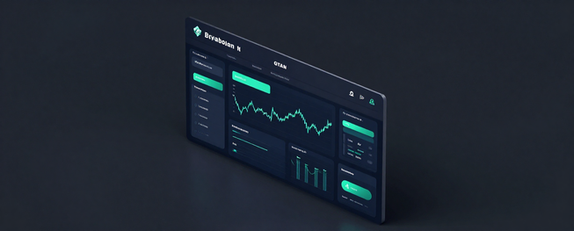

Loan Origination Workflow
01
Digital Application Intake
02
Risk Assessment & Decisioning
03
Agreement, Collateral & Funding
Borrowers submit loan requests via a secure digital portal with KYC/AML verification. Applicants specify loan amount, preferred crypto collateral, and loan tenure. Real-time wallet verification confirms asset ownership and collateral eligibility before proceeding.
The LOS engine performs automated credit scoring and collateral valuation using live market data feeds. Loan-to-Value (LTV) ratios are calculated dynamically. Risk tiers are assigned and approval decisions are rendered instantly, with escalation paths for complex cases requiring manual underwriter review.
Upon approval, smart contracts execute binding loan agreements. Crypto collateral is locked in a secure custodial vault or on-chain escrow. Funds are disbursed to the borrower's designated account within minutes, initiating the LMS servicing lifecycle with automated repayment scheduling.
Crypto Lending Platform — Confidential

Slide 6
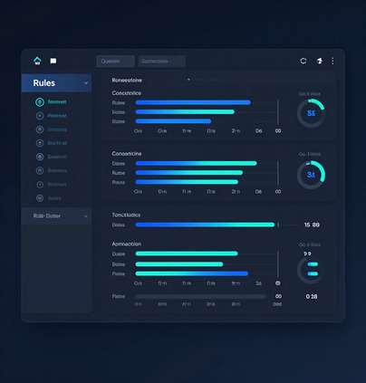
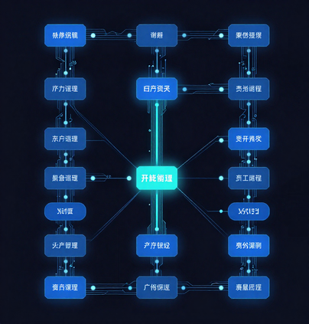
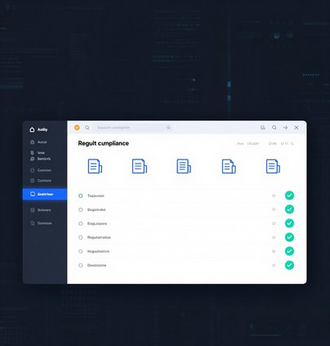
Platform
Capabilities
Product & Policy Rules
Automated Workflows
Compliance & Audit
Fully configurable loan product parameters including LTV ratios, collateral types, interest rate models, and margin call thresholds. Policy rules adapt dynamically to crypto asset volatility and borrower risk profiles.
AI-driven decision engines automate credit scoring, collateral valuation, and loan origination workflows. Real-time triggers manage liquidation events, repayment schedules, and borrower notifications end-to-end.
Built-in regulatory compliance with full auditability across all loan lifecycle events. Automated document generation, e-signature integration, and immutable audit trails ensure readiness for financial regulators.

Slide 7

Loan Management System (LMS)
1
Repayment Schedules & Servicing
2
Interest, Fees & Accruals
Automated amortization schedules for crypto-backed loans with flexible repayment terms. Supports bullet, interest-only, and installment structures with real-time borrower dashboards and payment tracking.
Dynamic interest accrual engine supporting fixed, variable, and tiered rate models. Automated fee computation — origination, late payment, and prepayment — with full GL-ready accounting entries.
3
Collateral Monitoring & Margin Calls
4
Delinquency, Restructuring & Collections
24/7 real-time LTV monitoring across crypto collateral positions. Automated margin call triggers at defined thresholds with multi-channel borrower alerts and configurable liquidation waterfalls.
Rule-based delinquency workflows with automated escalation, cure period management, and restructuring options. Integrated collections module supports collateral liquidation and recovery tracking for non-performing loans.

Slide 8

Solution Architecture
An API-first, microservices-driven architecture powers the Crypto Lending Platform — integrating blockchain custody, real-time oracle feeds, and enterprise-grade security with full observability across every layer.
API & Integration Layer
Data, Security & Observability
Blockchain & External Connectivity
RESTful & GraphQL APIs expose all LOS/LMS services. An API gateway enforces auth, rate-limiting, and routing. Webhooks and event streams connect CRM, ERP, and third-party KYC/AML providers seamlessly.
Encrypted data-at-rest and in-transit with HSM-backed key management. Role-based access control enforces least privilege. Centralized logging, distributed tracing, and real-time alerting ensure full-stack observability.
Smart contract integrations manage on-chain collateral locking and liquidation. Institutional custody APIs (Fireblocks/BitGo) secure digital assets. Chainlink oracles deliver tamper-proof price feeds for real-time LTV calculations.

Slide 9

Risk & Controls Framework
01
Compliance & Screening
02
Collateral & Market Risk
03
Governance & Audit
End-to-end KYC/AML workflows with automated identity verification, sanctions screening (OFAC, UN, EU lists), and PEP checks. Continuous transaction monitoring flags suspicious activity in real time, ensuring full regulatory compliance.
Real-time crypto collateral valuation with configurable LTV thresholds (e.g., 50–70%). Automated margin calls and liquidation triggers protect platform solvency. Multi-oracle price feeds mitigate market-risk exposure.
Role-based access controls (RBAC) enforce least-privilege across all modules. Immutable audit trails log every action for regulatory review. Automated reporting supports SAR filings, FinCEN, and jurisdictional disclosure mandates.
www.reallygreatsite.com

Slide 10



Implementation
Roadmap
Phase 1: Foundation & MVP
Phase 2: Automation & Scale
Phase 3: Ecosystem Expansion
Deploy core LOS/LMS architecture, crypto wallet integration, BTC/ETH collateral support, KYC/AML onboarding, and basic loan origination workflows. Target: live MVP within 90 days.
Introduce smart contract automation, dynamic LTV engine, multi-chain collateral support, risk scoring models, borrower portal, and institutional API integrations for scale.
Launch advanced DeFi products, cross-border lending, predictive analytics, secondary market capabilities, and partner ecosystem integrations to drive global growth.

